Slide 1
Data Warehousing and BI Week # 04

Slide 2
What is data model
It is the process of organizing data to be logically stored in a database.
Dimensional data modeling is one of the technique for data model.
Dimensional data modeling is a design technique used in data warehousing to optimize the retrieval and analysis of data for reporting and decision-making. It organizes data into a structure that is easy to understand and query, typically using a star or snowflake schema

Slide 3
Importance of dimensional data modeling
To ensure data quality and accuracy in a database
To define relationships, primary and foreign keys
To provide optimized database for fast queries.

Slide 4
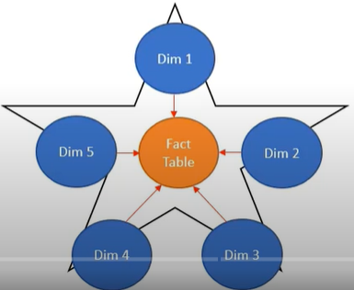
Dimensional Data model
For instance, star schema is a denormalization technique, where a fact table is surrounded by multiple dimensions and constraint by primary and foreign keys.
Star Schema

Slide 5
Dimensional Data model--Steps
Identify the Business Process: The operational activities benign modeled:
Example : Analyze sale data for retail company the business process is “Sales Transactions” This involves various operational activities e.g. recording customer purchases, managing inventory levels, tracking payment methods, processing returns.
Define the grain: The lowest level of information
The grain specifies the level of detail or the lowest level of data that will be captured in your fact table. It essentially answers the question: "What does each row in my fact table represent?"
Define Dimension Tables: contains the descriptive entities of the data
Identify the Facts: Are the numeric measurements that result from business process

Slide 6
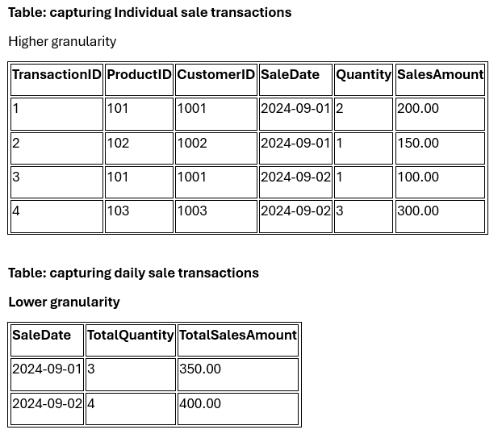
Granularity example

Slide 7
Fact table
The numeric measure
Foreign keys of the associated dimensions
Degenerate dimensions key- generally no associated dimension table.
Date/time stamps

Slide 8
Normalization vs Denormalization
Normalization in data warehousing is the process of organizing data to reduce redundancy and improve integrity. Denormalization, on the other hand, simplifies the data structure for faster query performance by combining tables

Slide 9
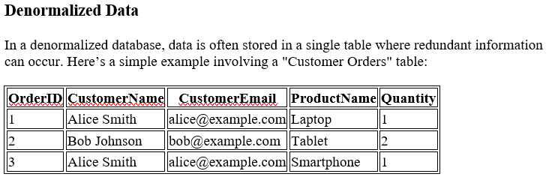
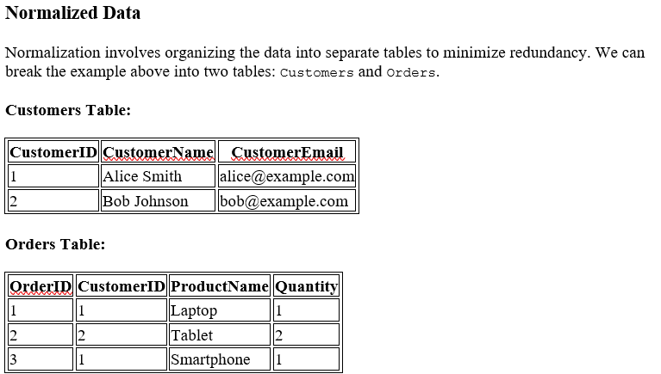
Example- How does Normalization reduce redundancy compared to Denormalization

Slide 10
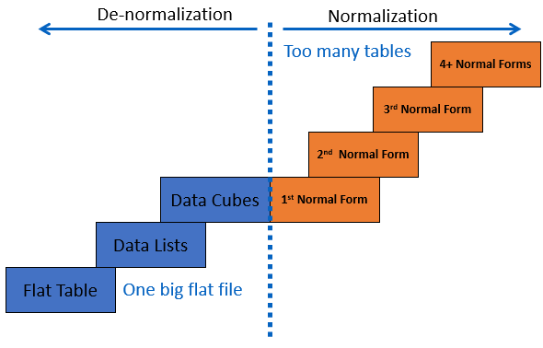
Denormalization

Slide 11
De-normalization
De-normalization specifically improves performance by either:
Reducing the number of tables, which consequently speeds up performance.
Reducing the number of joins required during query execution, or

Slide 12
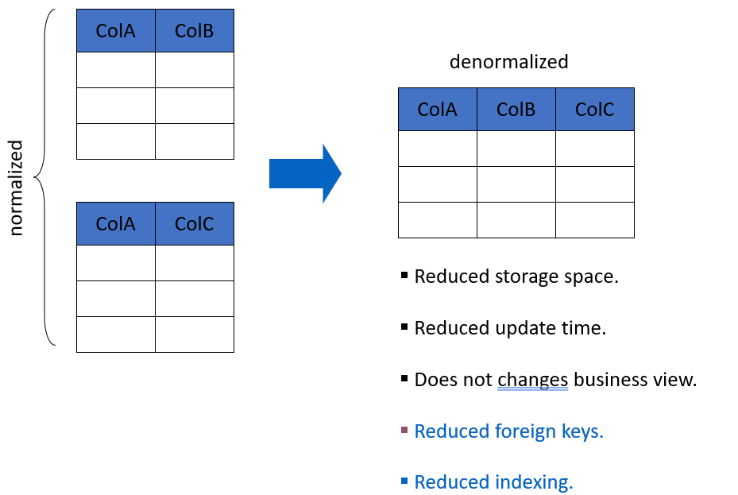
OLTP vs OLAP (normalization and denormalization)
Normalization is primarily used in OLTP (Online Transaction Processing) systems to ensure data integrity and minimize redundancy. Denormalization is often used in OLAP (Online Analytical Processing) systems to enhance query performance and simplify data retrieval.

Slide 13
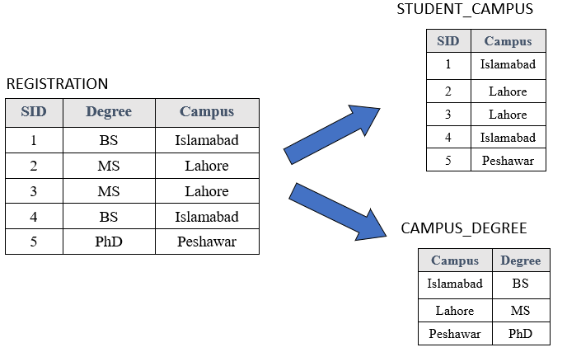
Normalization

Slide 14
Data warehouse Schema
Schema is a logical description of the entire database. It includes the name and description of records of all record types including all associated data-items and aggregates.
Star Schema
Snowflake Schema

Slide 15
Star Schema
Each dimension in a star schema is represented with only one-dimension table.
This dimension table contains the set of attributes.
The following diagram shows the sales data of a company with respect to the four dimensions, namely time, item, branch, and location.
There is a fact table at the center. It contains the keys to each of four dimensions.
The fact table also contains the attributes, namely dollars sold and units sold.

Slide 16
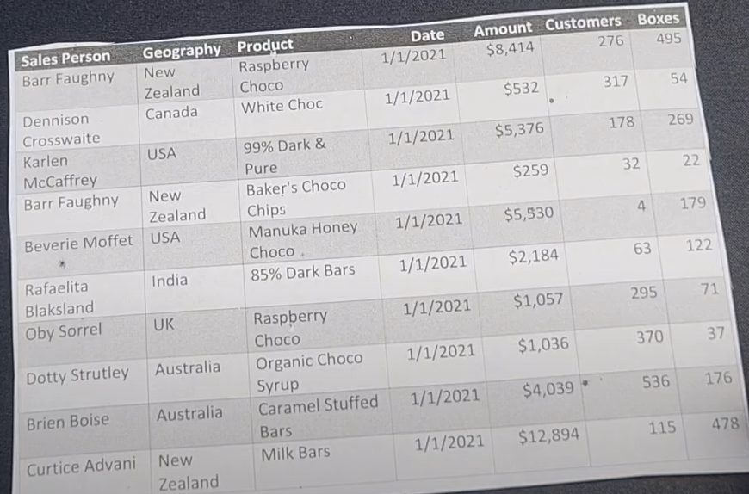
Excercise

Slide 17
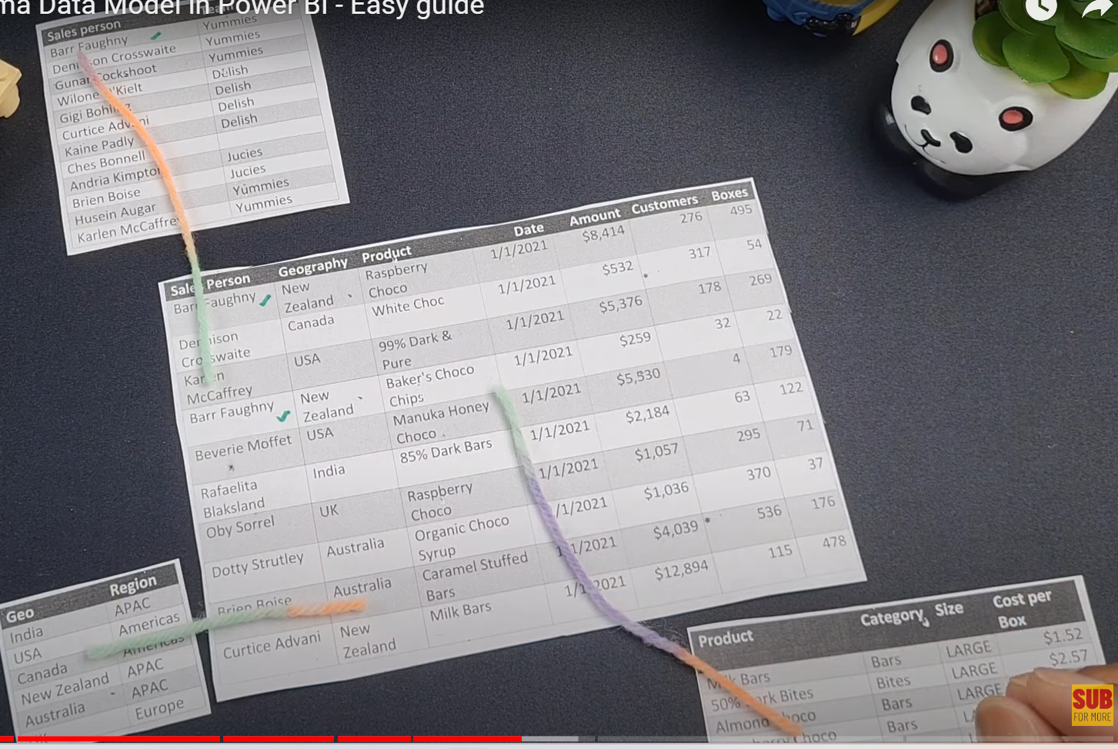
Star schema

Slide 18
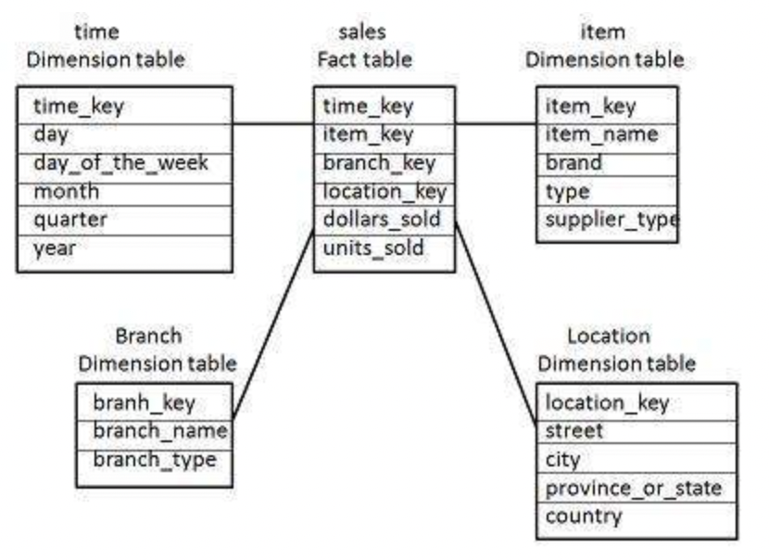
Star Schema

Slide 19
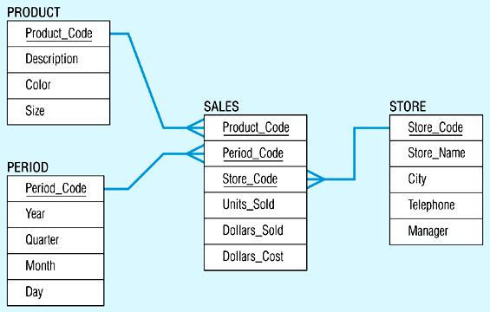
Star Schema Example

Slide 20
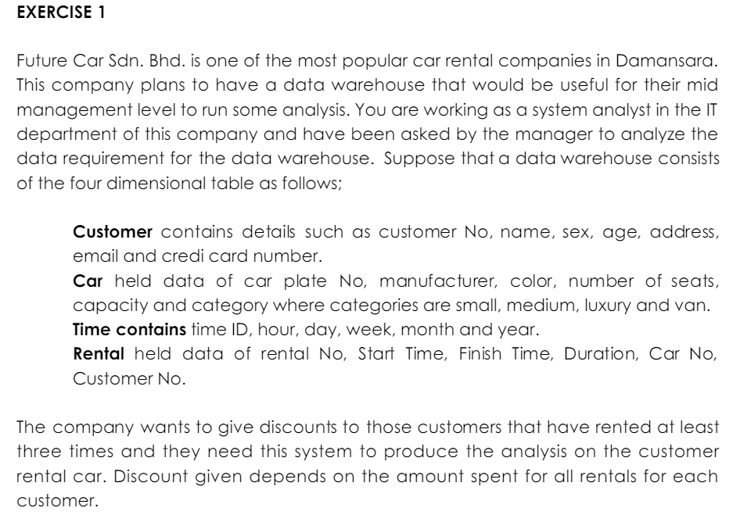
Exercise – car rental company

Slide 21
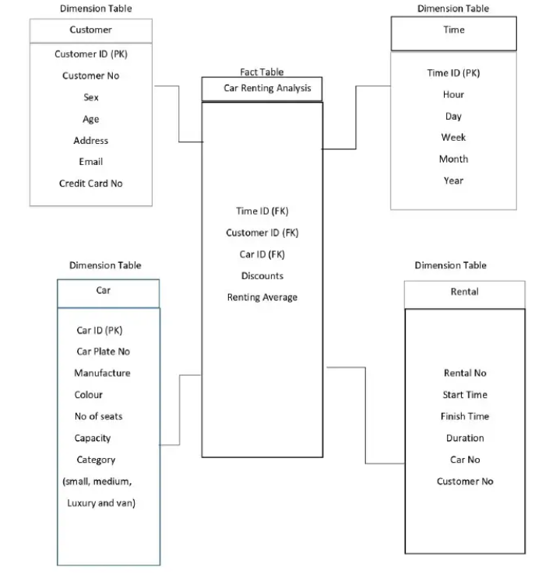
exercise

Slide 22
Snowflake Schema
Snowflake schema is a type of star schema but a more complex model.
“Snowflaking” is a method of normalizing the dimension tables in a star schema.
The normalization eliminates redundancy.
The result is more complex queries and reduced query performance.

Slide 23
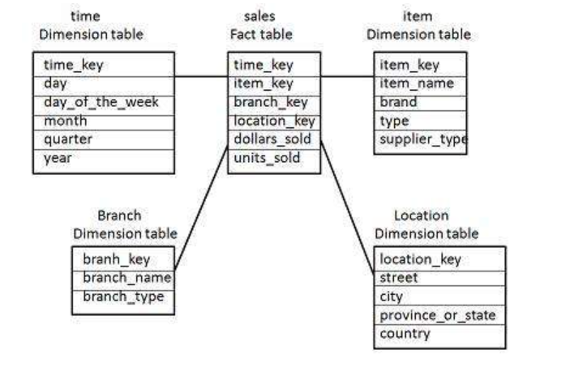
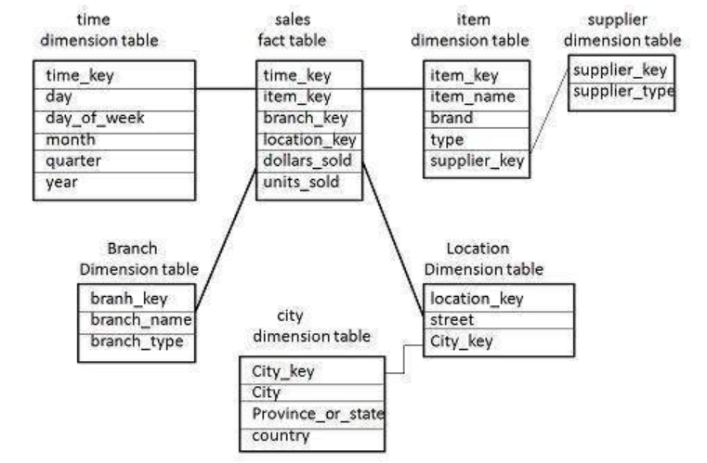
Snowflakes schema
Star schema
Snowflakes schema

Slide 24
Snowflaking
The attributes with low cardinality in each original dimension table are removed to form separate tables. These new tables are linked back to the original dimension table through artificial keys.
Product key
Product name
Product code
Brand key
Brand key
Brand name
Category key
Category key
Product category

Slide 25
Snowflake Schema
Advantages:
Small saving in storage space
Normalized structures are easier to update and maintain
Disadvantages:
Schema less intuitive and end-users are put off by the complexity
Ability to browse through the contents difficult
Degrade query performance because of additional joins

